Slide 1
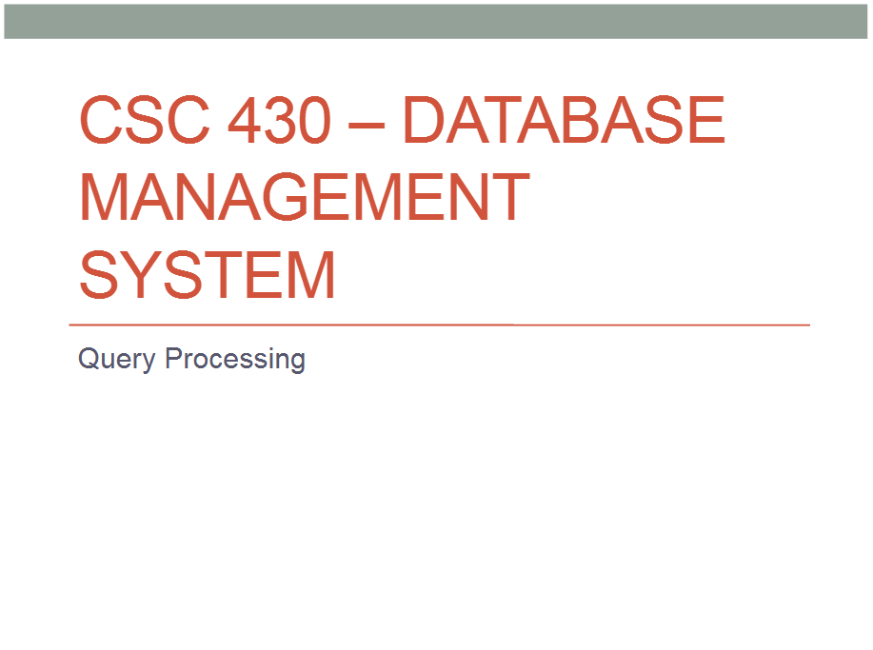
LECTURE 20: Query Processing and Optimization

Slide 2
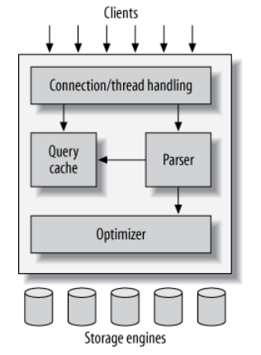
The client sends the SQL statement to the DBMS server.
The server checks the query cache. If there’s a hit, it returns the stored result from the cache; otherwise, it passes the SQL statement to the next step.
The server parses, preprocesses, and optimizes the SQL into a query execution plan.
The query execution engine executes the plan by making calls to the storage engine API.
The server sends the result to the client.

Slide 3
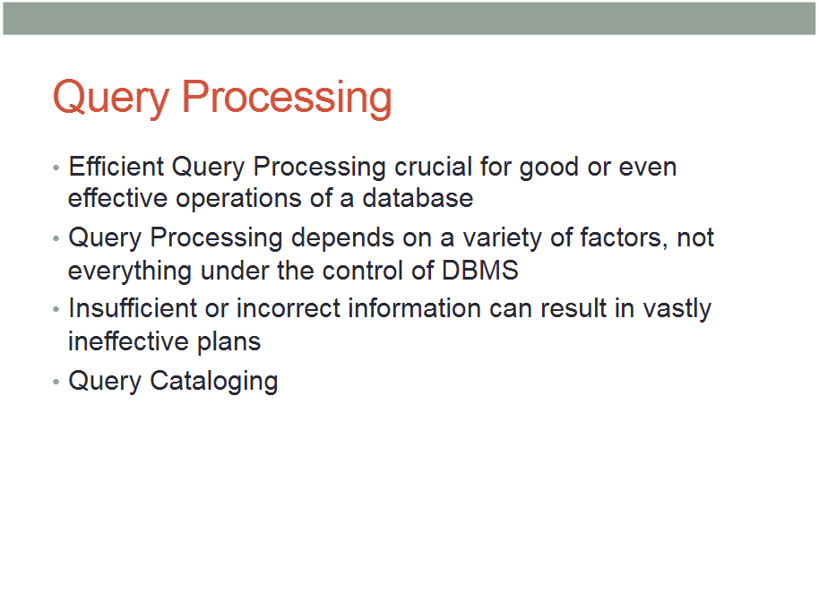

Slide 4
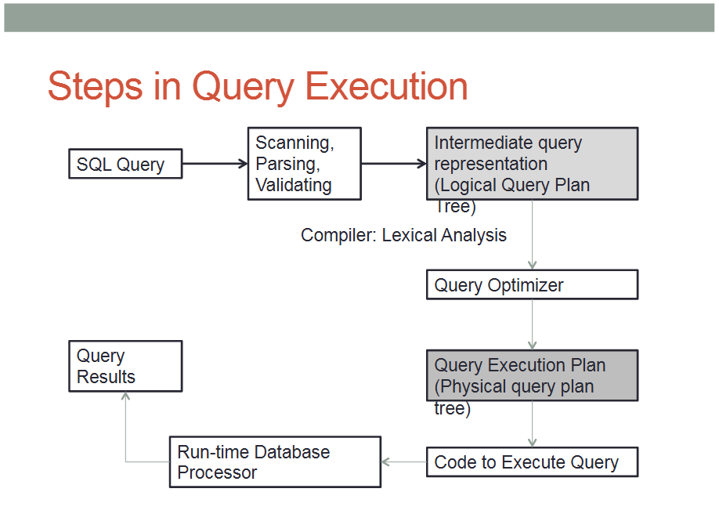

Slide 5
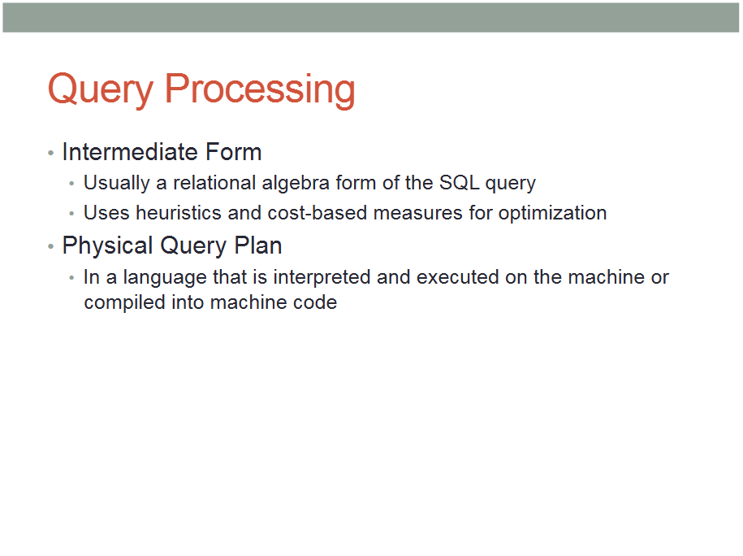
/ Logical Query Plan

Slide 6
Intermediate Form or LOGICAL QUERY PLAN

Slide 7
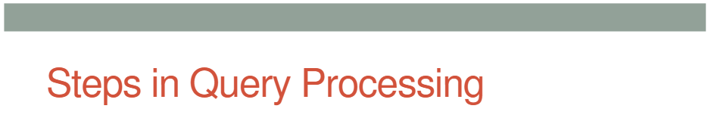
CATALOG
Logical Query Plan
Query rewriting
Parse Tree

Slide 8
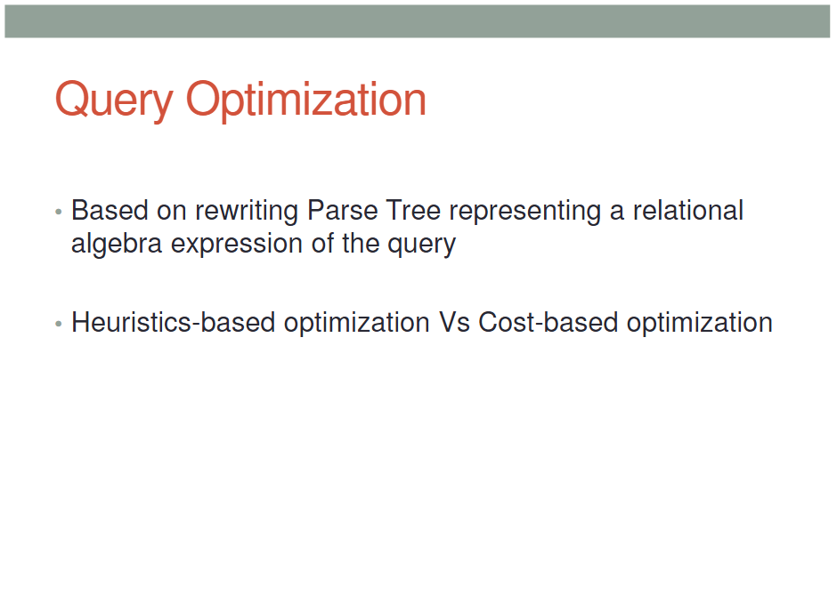

Slide 9
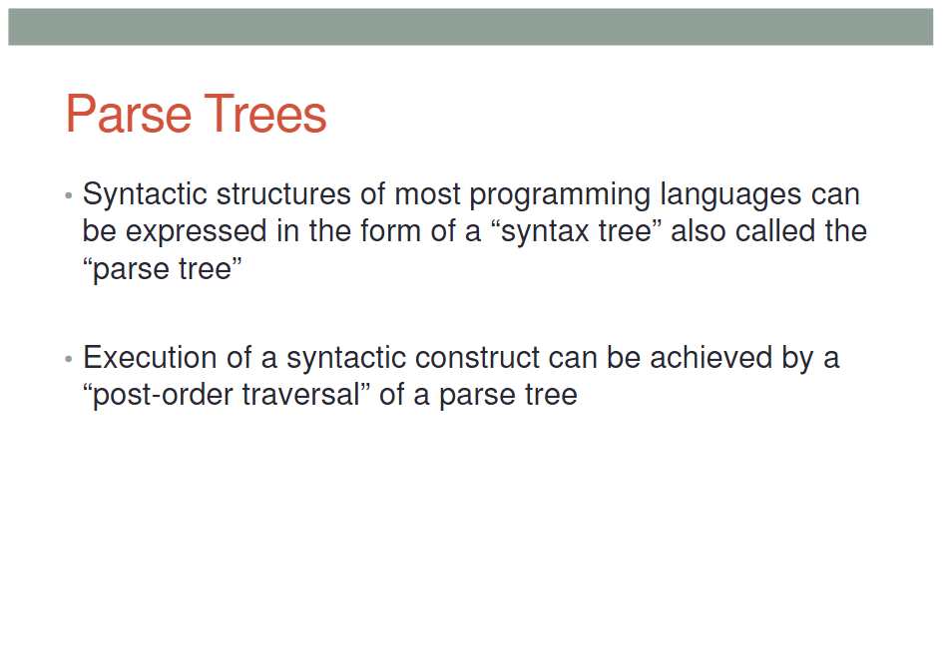

Slide 10
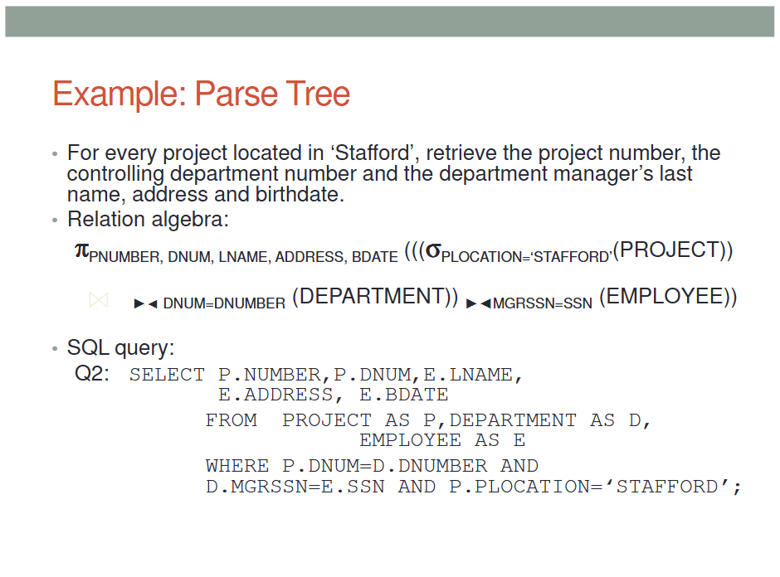

Slide 11
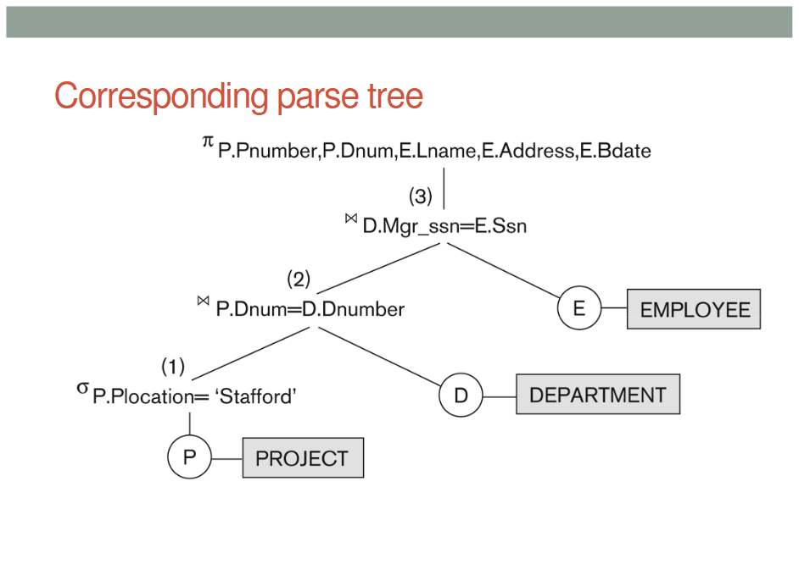

Slide 12
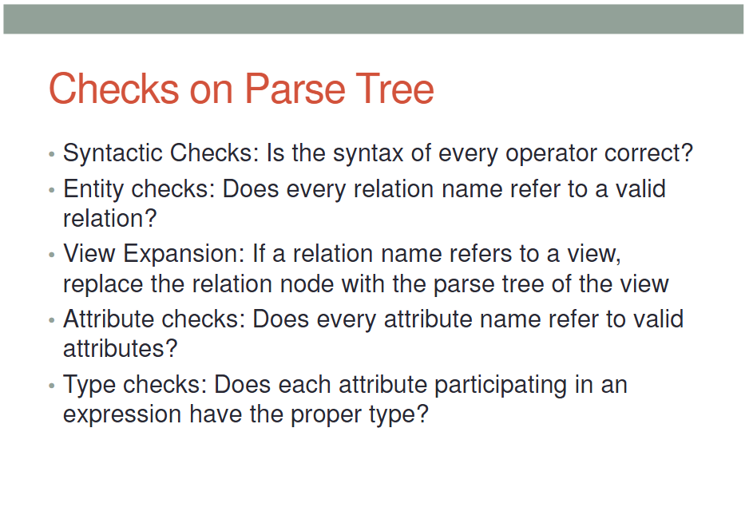

Slide 13
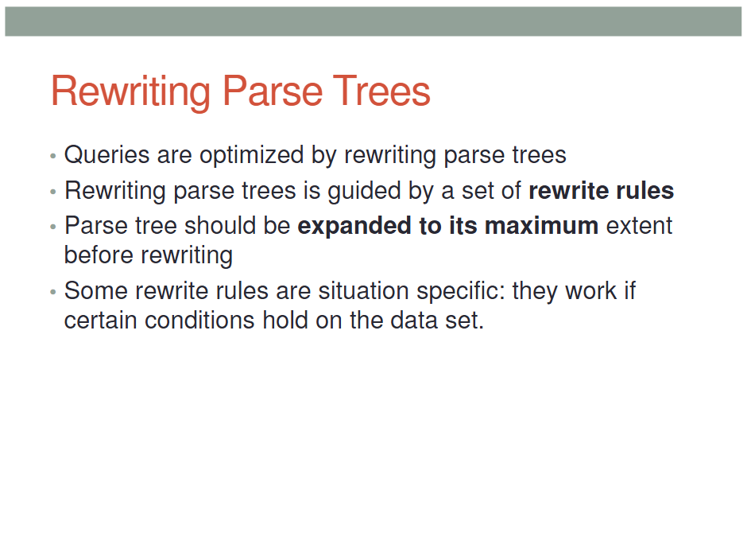

Slide 14
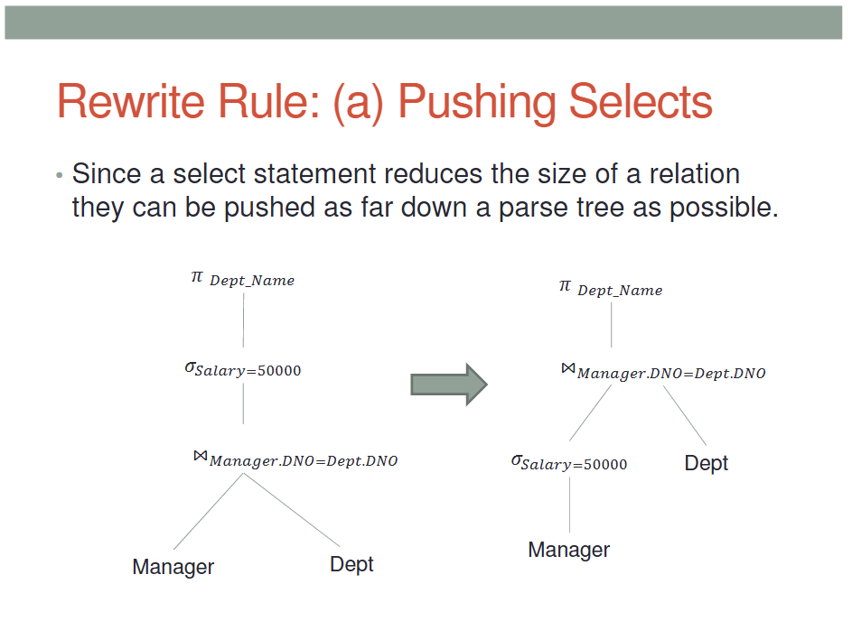
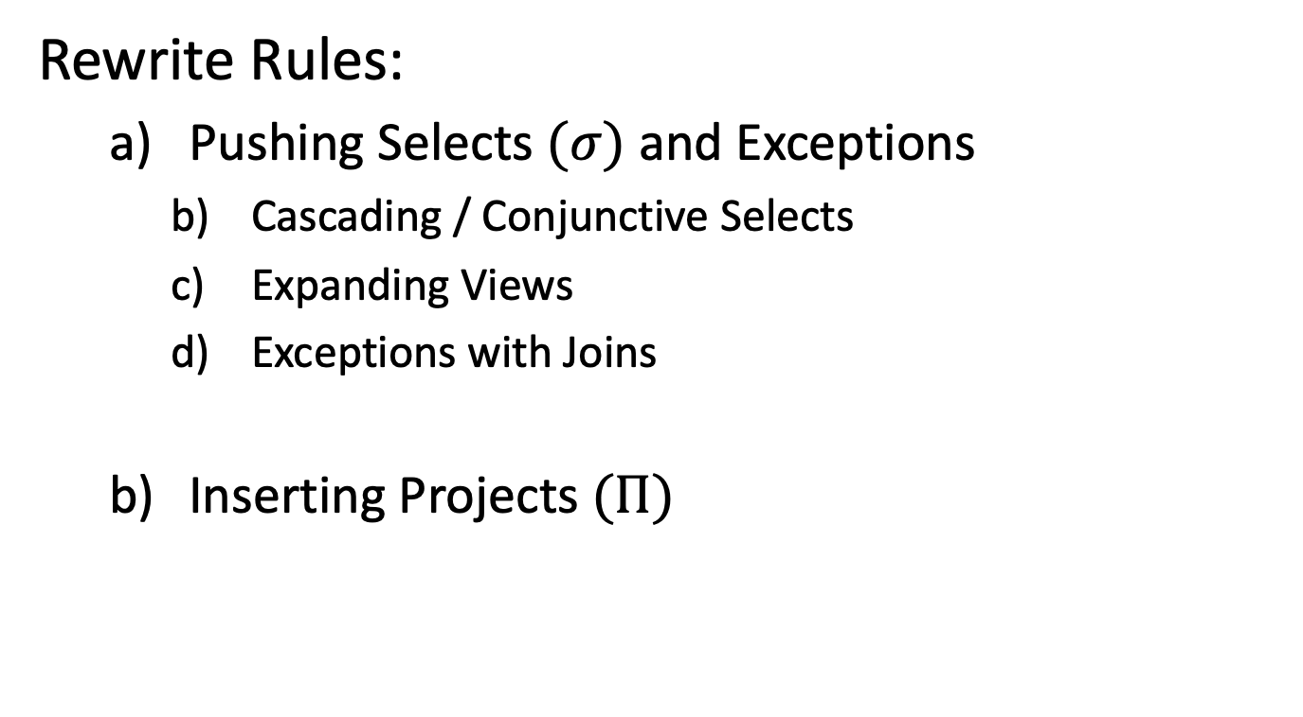
Thumb Rules
Rewrite Rules:
Pushing Selects $(σ)$ and Exceptions
Cascading / Conjunctive Selects
Expanding Views
Exceptions with Joins
Inserting Projects $(Π)$

Slide 16
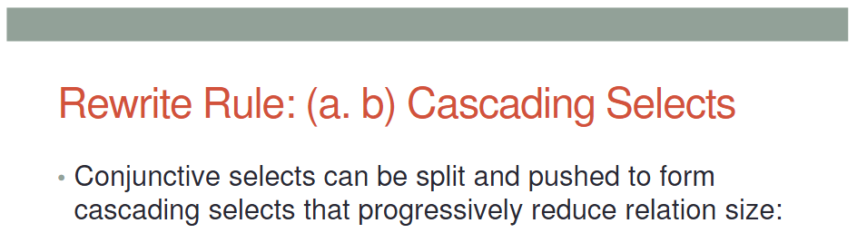
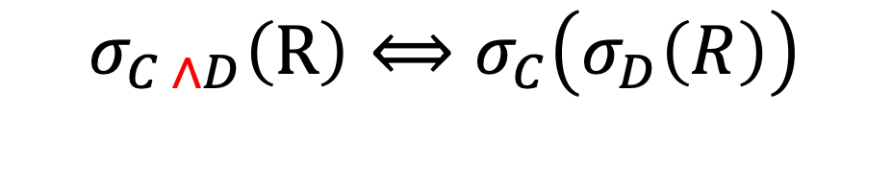
$$σ_{C ∧D}\left(R\right)⟺σ_{C}\left(σ_{D}\left(R\right)\right)$$

Slide 17
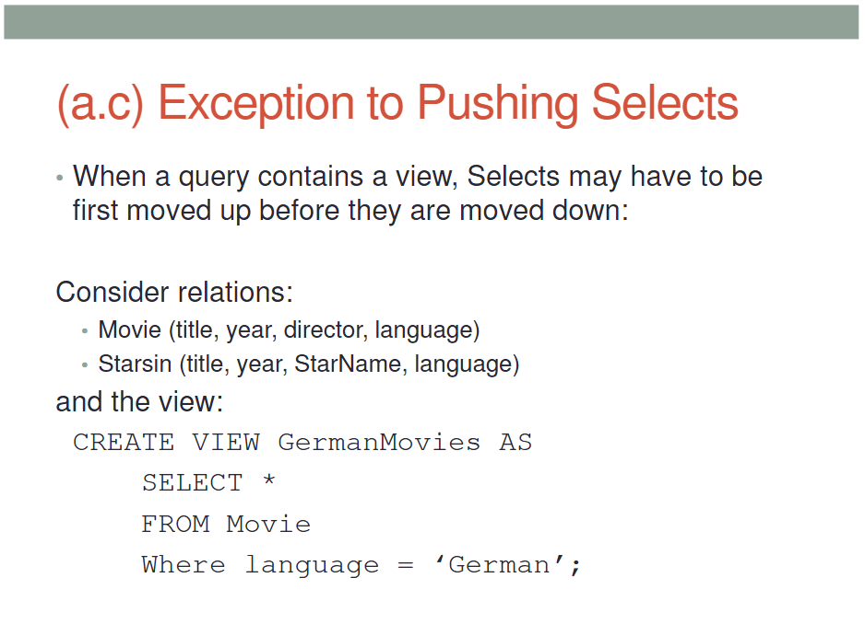
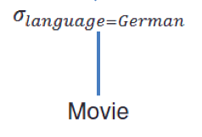
(VIEWS)

Slide 18
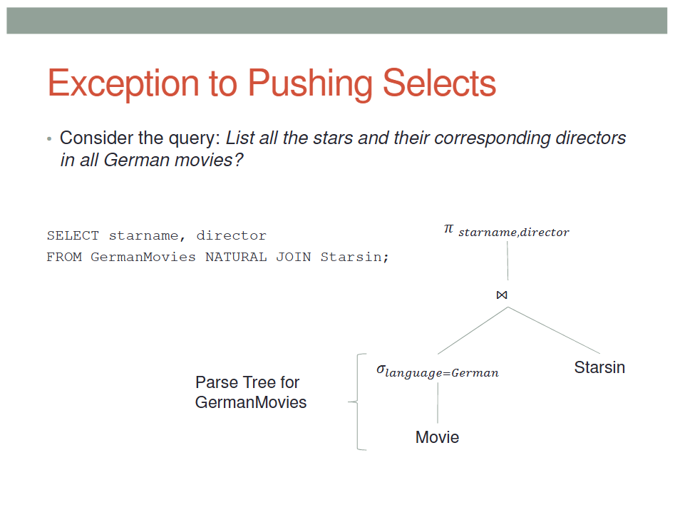

Slide 19
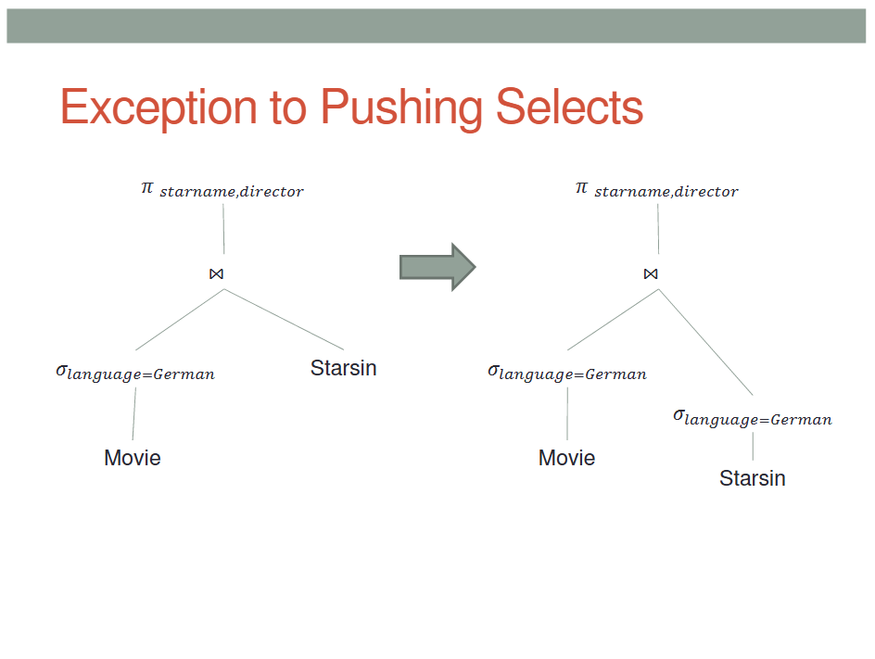

Slide 20
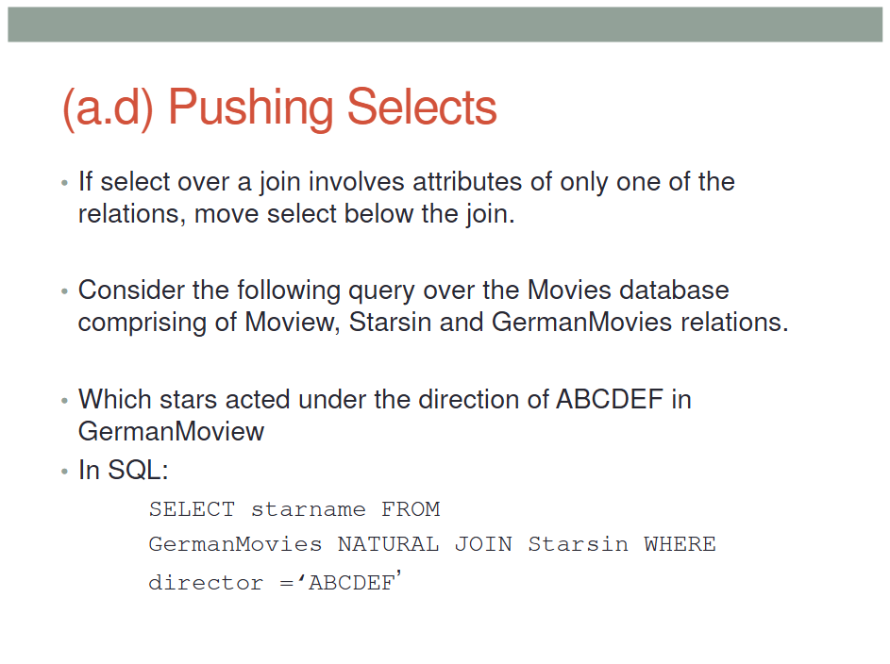
(in JOINS)
,
GermanMovies,

Slide 21
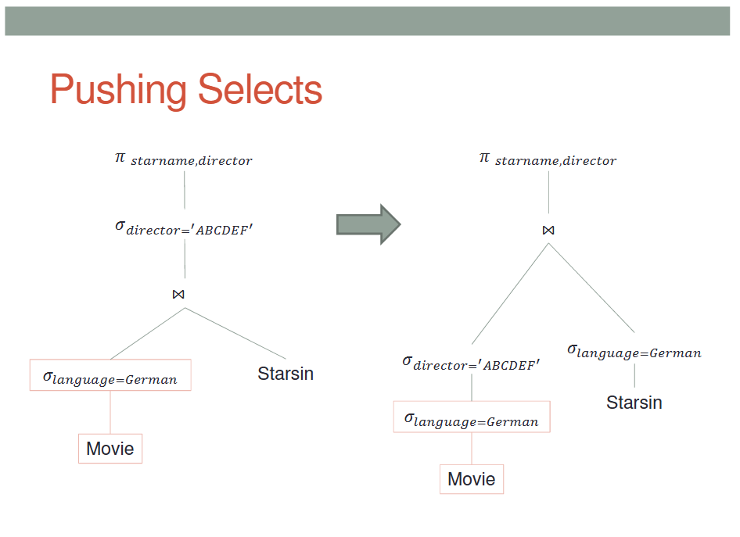

Slide 22
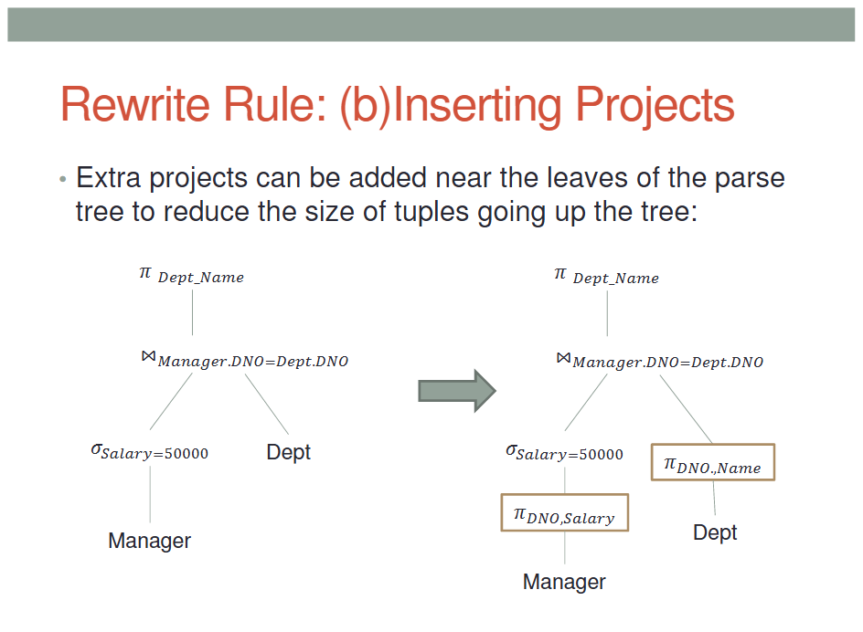

$π$DNO, Dept_Name

Slide 23
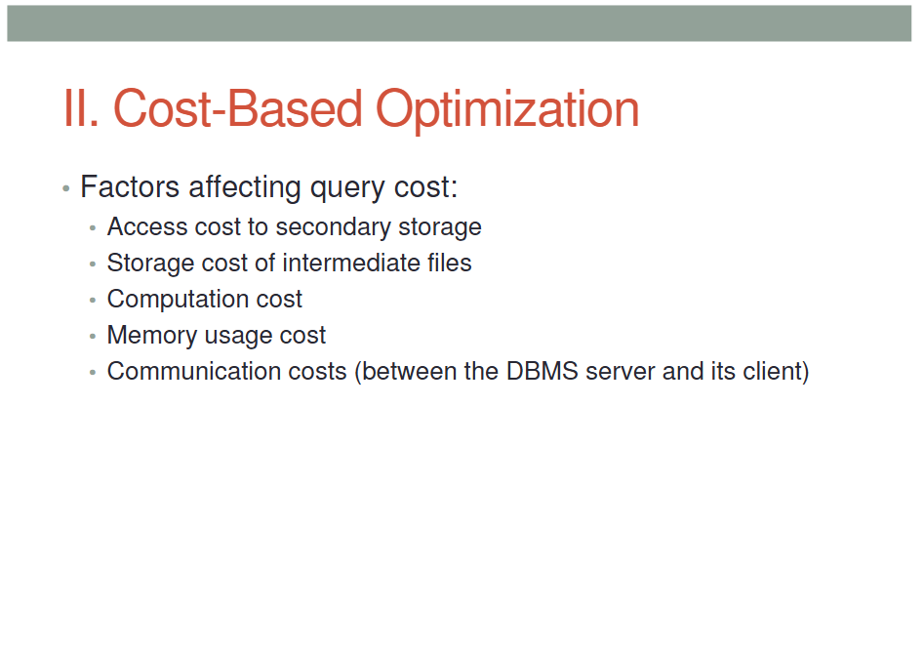

Slide 24
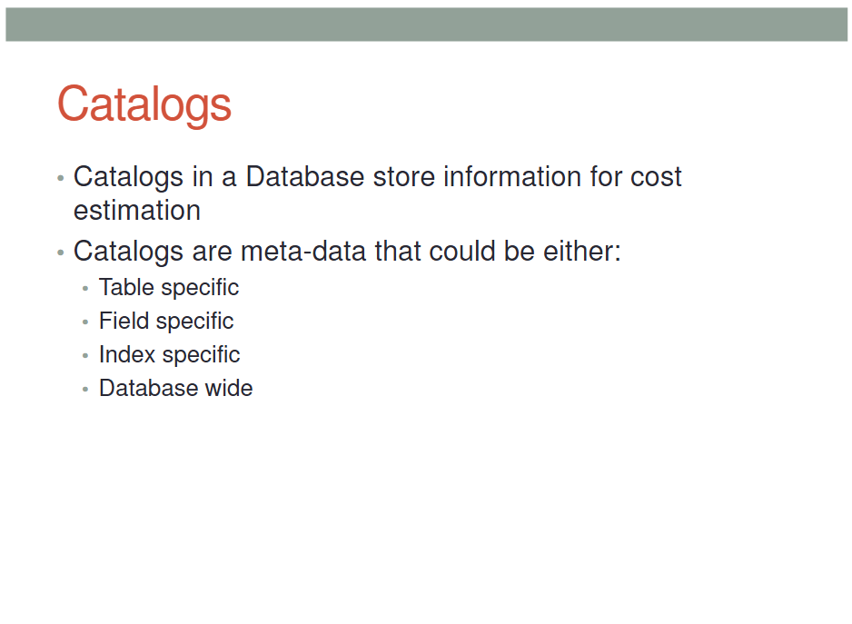

Slide 25
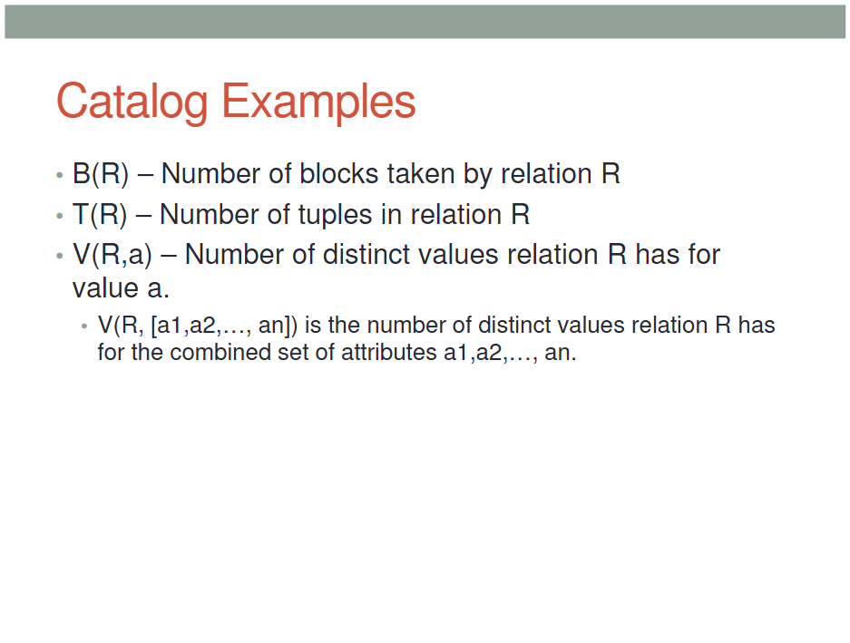

Slide 26
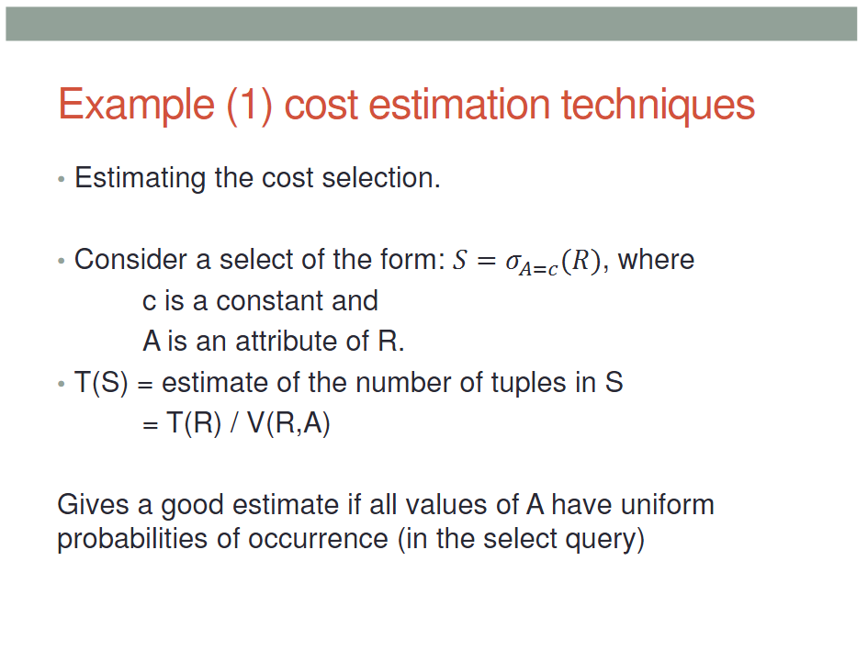

$$\left(\frac{T(R)}{V\left(R, ‘c’\right)}\right)$$

Slide 27
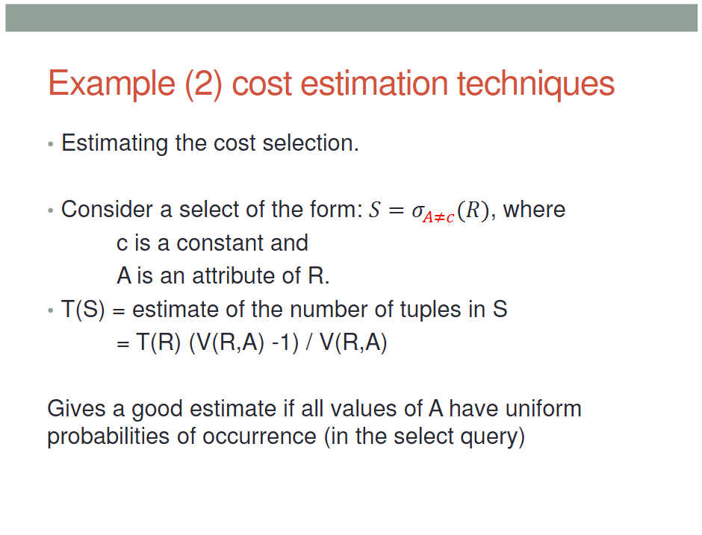
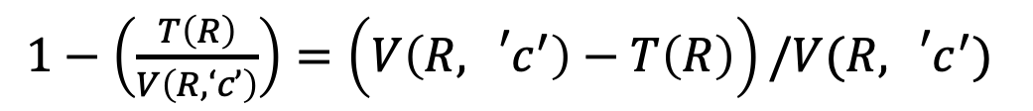
$1−\left(\frac{T\left(R\right)}{V\left(R, ‘c’\right)}\right)=\left(V\left(R,{{}_{}^{′}c}^{′}\right)−T\left(R\right)\right)/V(R,{{}_{}^{′}c}^{′})$

Slide 28
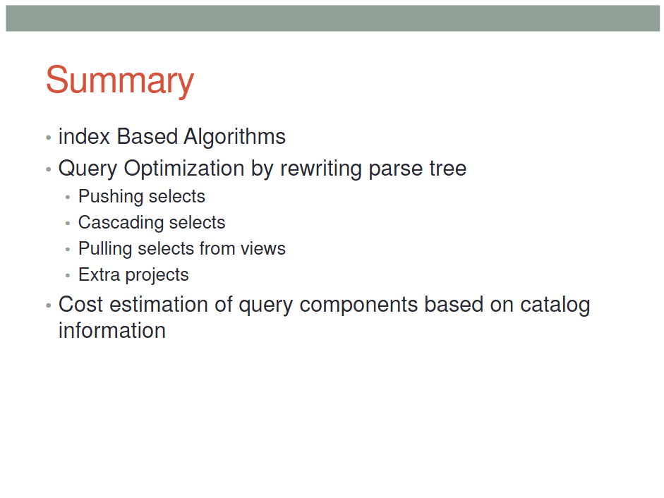

Slide 29
Physical Query Plan Lecture 20
CSC 430/530 Database Management Systems / Database Theory

Slide 31
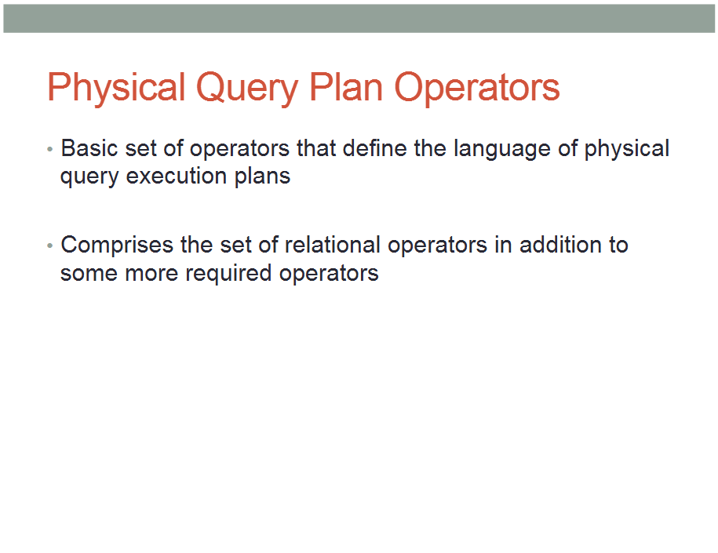

Slide 32
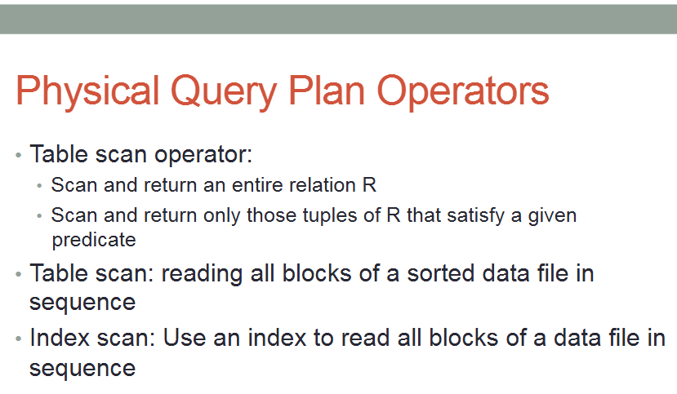
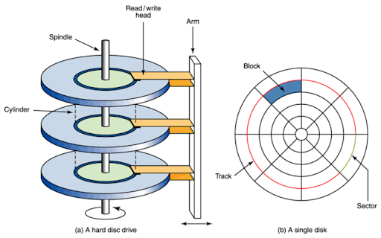
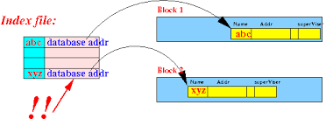

Slide 33
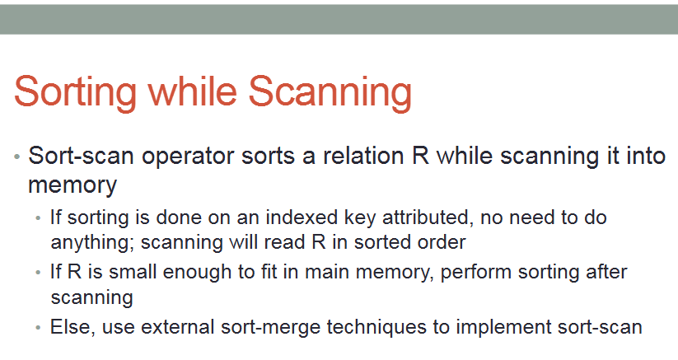

Slide 34
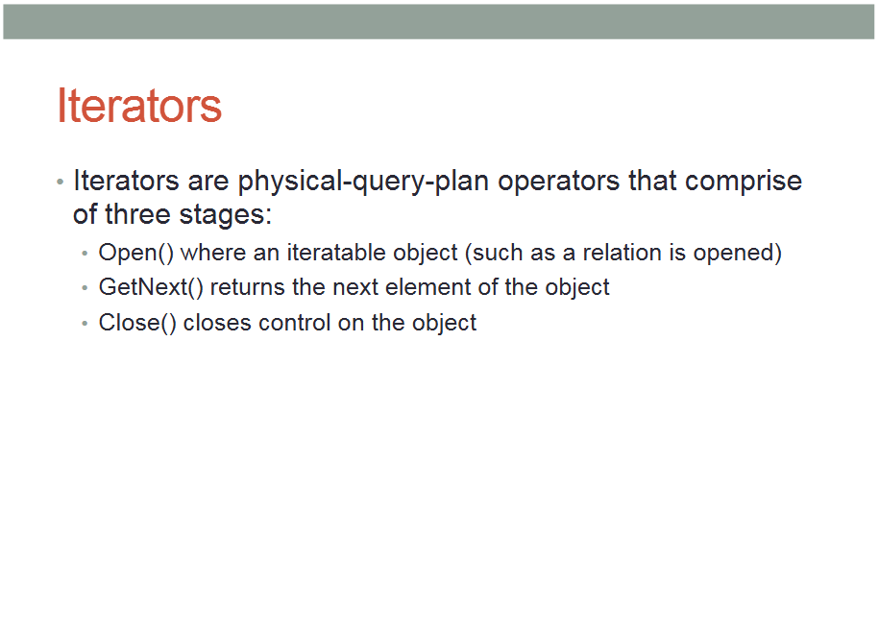

Slide 35
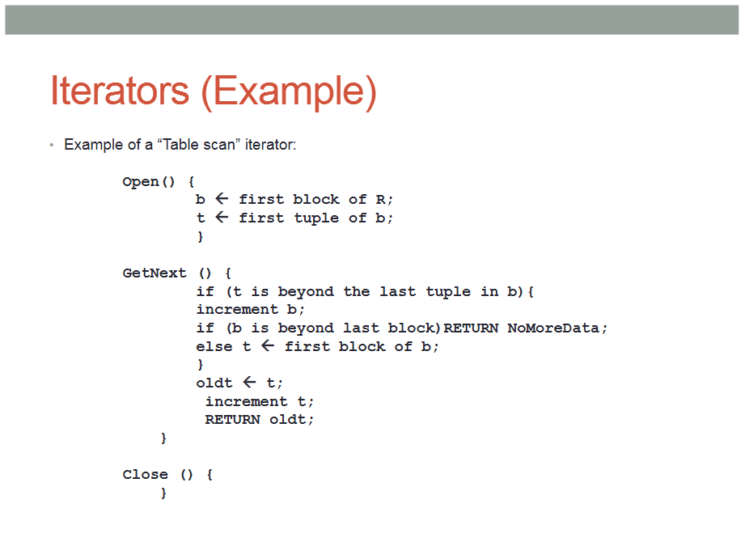

Slide 37
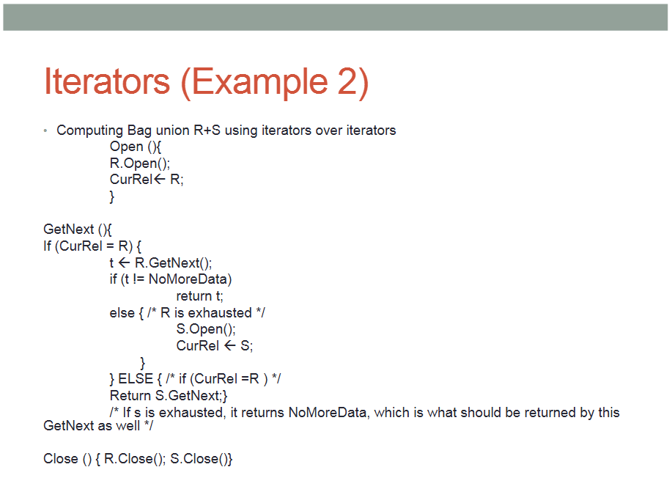

Slide 39
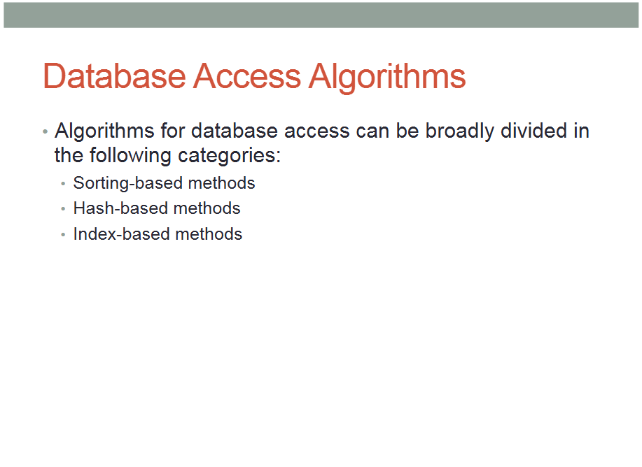

Slide 40
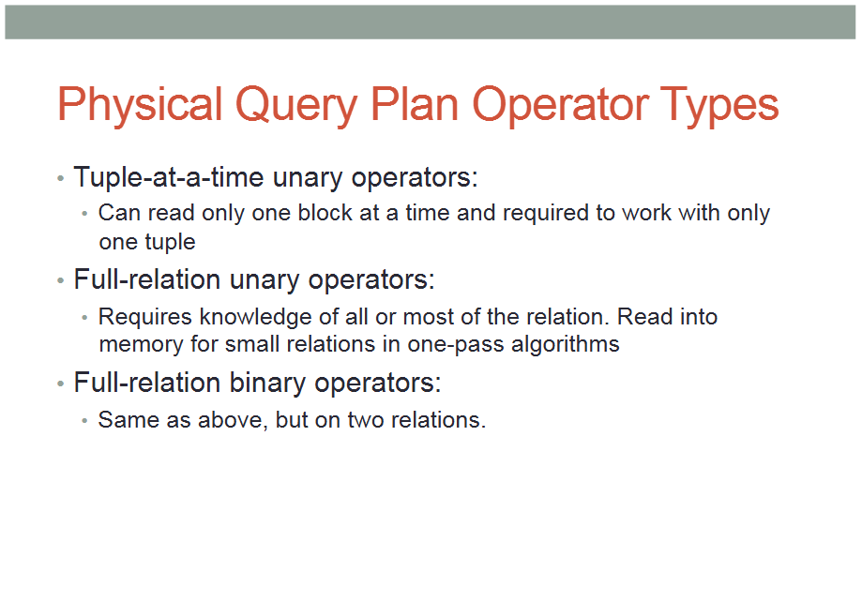

Slide 41
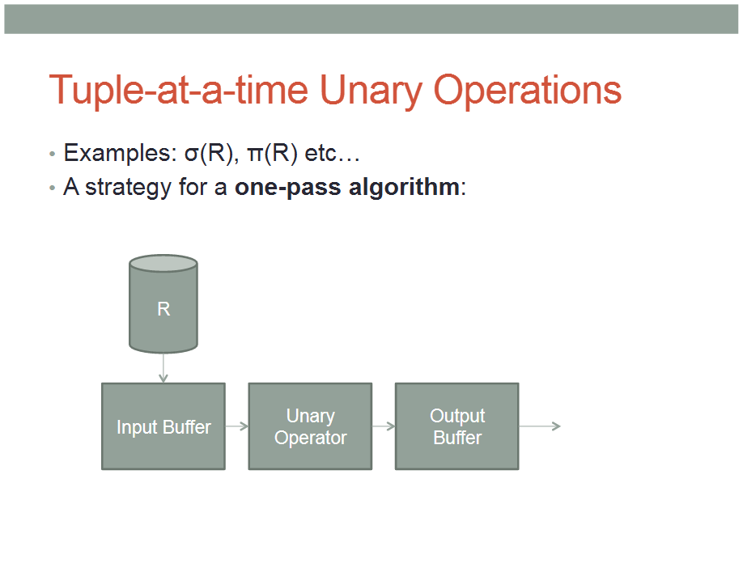

Slide 42
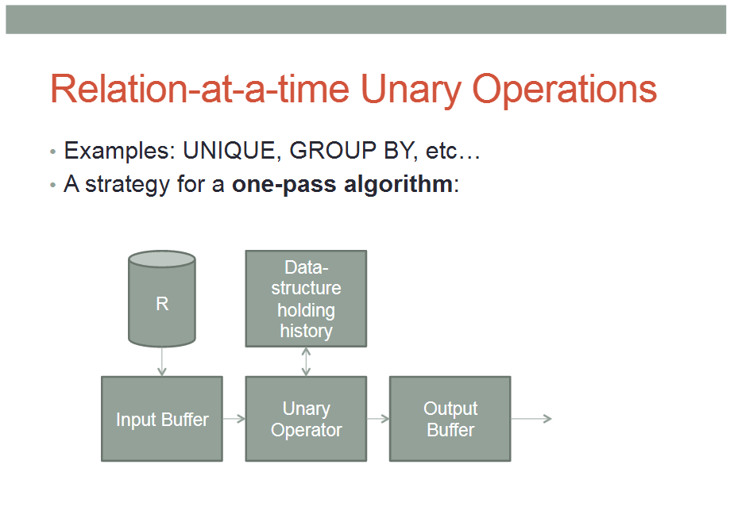

Slide 43
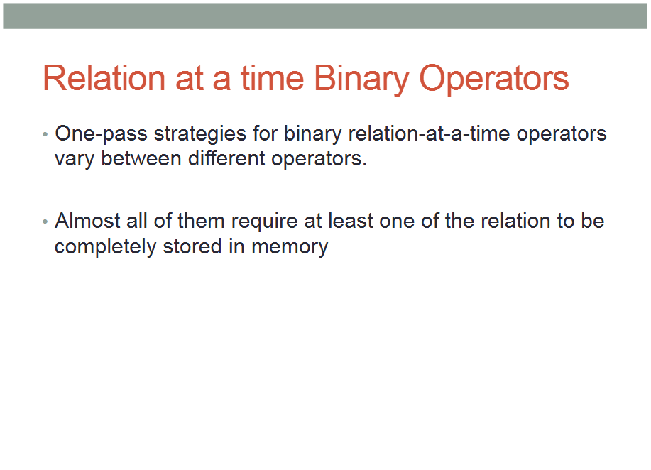

Slide 44
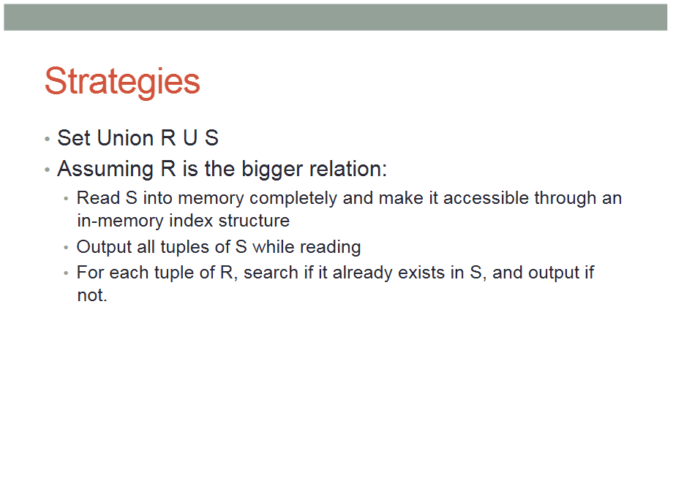

Slide 45
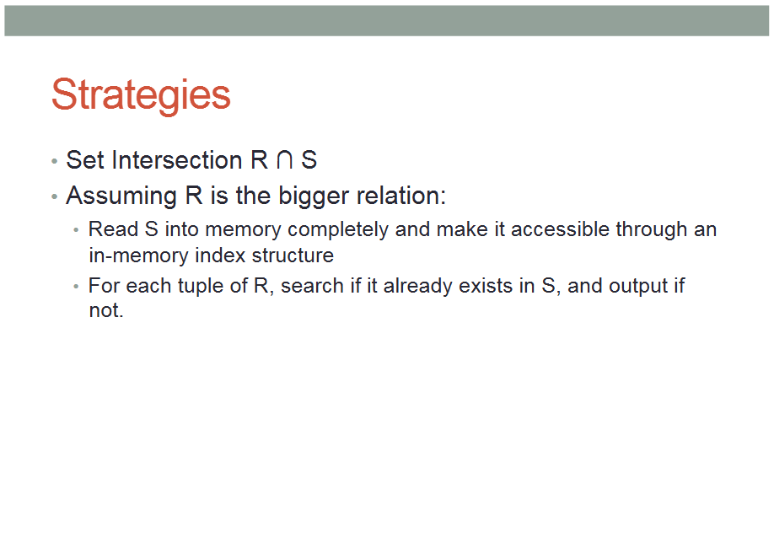

Slide 46
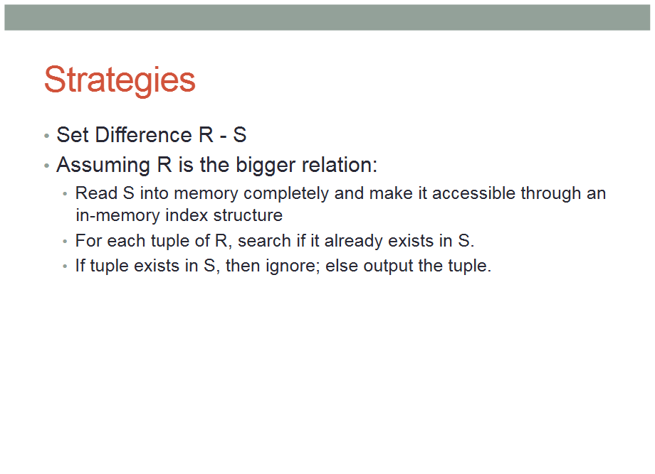

Slide 47
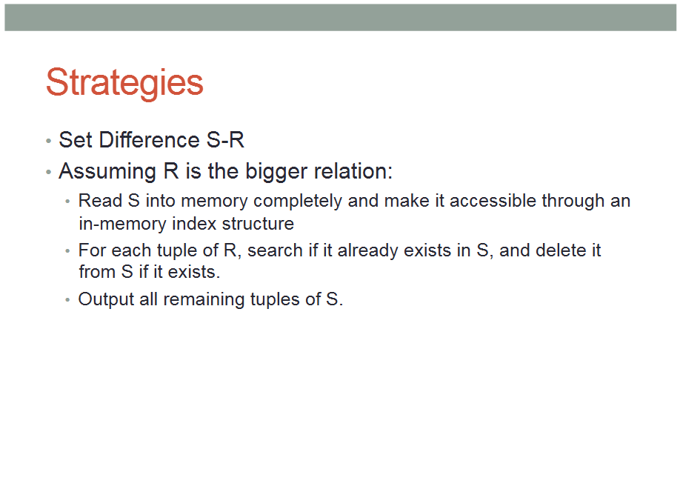

Slide 48
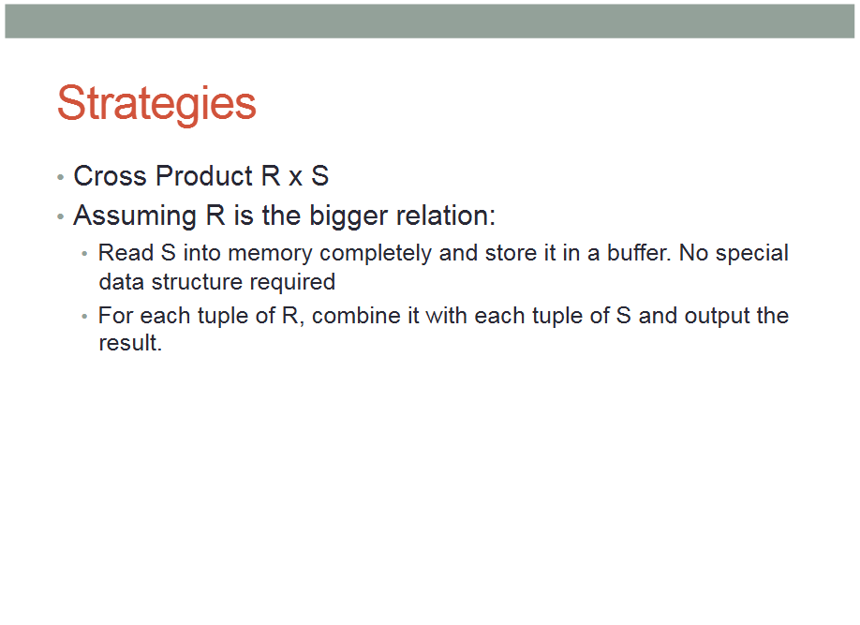

Slide 49
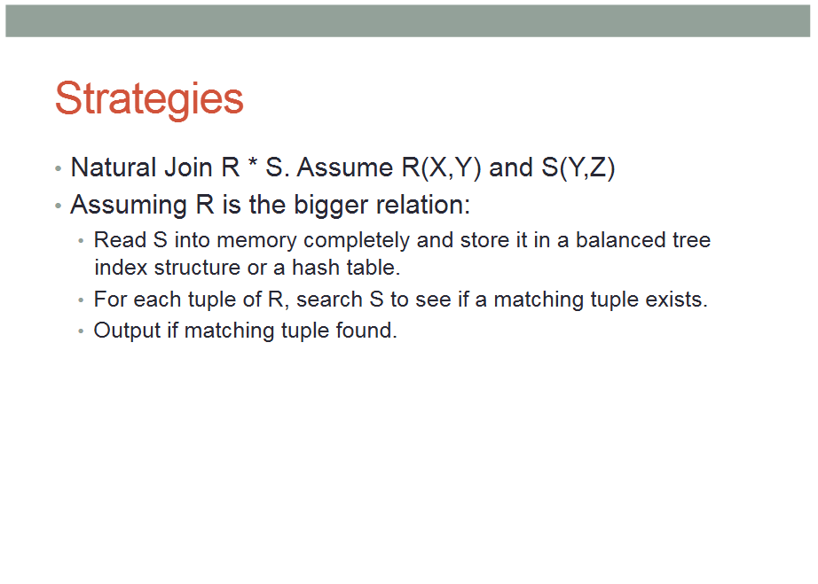

$$R⋈S$$

Slide 50


Slide 51


Slide 52


Slide 53


Slide 54


Slide 55
Example of two-phase algorithm:
Query: Duplicate elimination using sorting
Phase 1:
Let relation R, in which duplicates must be eliminated, be too big to fit in memory.
Step A: Read M << R blocks into memory and sort them.
Store the sorted set of M blocks back on disk
Return to step A till R is exhausted.

Slide 56

Example of two-phase algorithm:
Phase 2:
Take one block from each sorted sub-list on disk and eliminate duplicate tuples
More specifically: Take the first element p of the first block and move all other blocks to go beyond p.
Since blocks are sorted, the “merge-elimination” take $O(M×n×b),$where $M$ is the number of blocks in a sorted block set, $n$ is the number of block sets, and $b$ is the number of tuples in a block.

Slide 57


Slide 58


Slide 59


Slide 60


Slide 61



Slide 62
Summary
Multi pass algorithm
We know the two-phase algorithm
Duplicate elimination is important
Review basic operators

Slide 63


Slide 64


Slide 65


Slide 66


Slide 67


Slide 68


Slide 69


Slide 70


Slide 71


Slide 72


